Slide 1
Summary of Core Java
Diving into the Ocean!

Slide 2
Introduction to Java
Overview
Java is a high-level, class-based, object-oriented programming language that was first developed by Sun Microsystems in 1995 and is now owned by Oracle.
It was initially designed for embedded systems but soon became one of the most popular programming languages for web, mobile, and enterprise applications.

Slide 3
Introduction to Java
Key Features
Platform Independent
Object-Oriented
Robust and Secure
Scalable and Multithreaded

Slide 4
Introduction to Java
Key Principles
Write Once, Run Anywhere (WORA):
Java's biggest strength is its platform independence. Java programs are compiled into bytecode, which can be executed on any device with a Java Virtual Machine (JVM), regardless of the underlying hardware and OS.
Object-Oriented:
Java is built around the principles of Object-Oriented Programming (OOP), which helps in organizing complex programs through the concepts of classes and objects.
Secure and Robust:
Java emphasizes security through features like runtime checking and bytecode verification. It also has automatic garbage collection, reducing memory management issues.

Slide 5
Introduction to Java
Popular Uses
Enterprise Applications:
Java powers many large-scale enterprise applications and is used heavily in server-side technologies like Spring and Hibernate.
Mobile Development:
Java was the primary language for Android app development (until Kotlin emerged), making it highly relevant in mobile app creation.
Web Applications and Big Data:
With frameworks like Spring, Java is widely used in web development, and in Big Data with tools like Apache Hadoop.

Slide 6
Introduction to Java
Why Java Is Still Relevant?
Stable and Mature:
Java has a massive developer community and extensive documentation, making it a stable language for long-term projects.
Constant Evolution:
With regular updates (Java 8, 11, 17, etc.), the language has stayed relevant, adopting modern features such as lambdas, streams, and records to improve developer productivity.

Slide 7
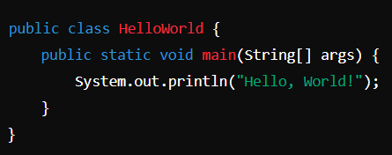
Basic Syntax and Structure
Java Program Structure
Class Declaration:
Every Java program is made up of classes. The name of the class should match the file name.
Main Method:
This is the entry point for any Java application. The main method is where the program execution begins.

Slide 8
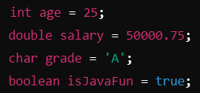
Basic Syntax and Structure
Basic Components Of Java
Variables:
A variable is a container to store data.
Common Types of Variables:
int – for whole numbers
Double – for floating-point numbers
Char – for a single character
boolean – for true/false values

Slide 9
Basic Syntax and Structure
Data Types
Primitive:
int
double
char
boolean, etc. (total 8 including byte, short, long and float)
Non-primitive:
Classes
Arrays
Interfaces

Slide 10
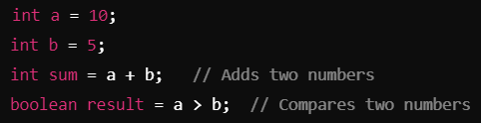
Basic Syntax and Structure
Operators
Operators are symbols used to perform operations on variables and values
Common Types of Operators
Arithmetic Operators:
+, -, *, /, %
Relational Operators:
==, !=, <, >, <=, >=
Logical Operators:
&&, ||, !

Slide 11
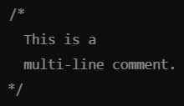
Basic Syntax and Structure
Comments
A comment is a line which is ignored by the compiler.
Types of Comments
Single-line comment:
// This is a single-line comment.
Muti-line comment:
/* This is a multi-line comment.*/

Slide 12
Control Statements
Control statements in Java dictate the flow of execution in a program. They allow you to make decisions, repeat actions, and execute code conditionally.
Important Control Statements
Conditional – if, if-else, if-else if-else
Looping – for, while, do-while
break and continue

Slide 13
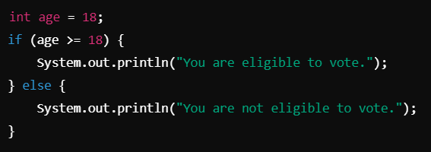
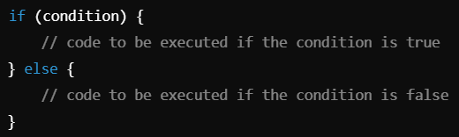
Control Statements – Conditional
if-else statement:
The if-else statement allows the program to take one action if a condition is true and another action if it is false.
Syntax

Slide 14
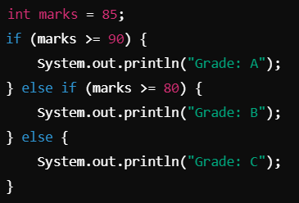
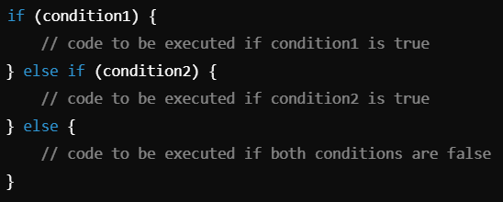
Control Statements – Conditional
else if ladder:
Use multiple conditions to decide between different alternatives.
Syntax

Slide 15
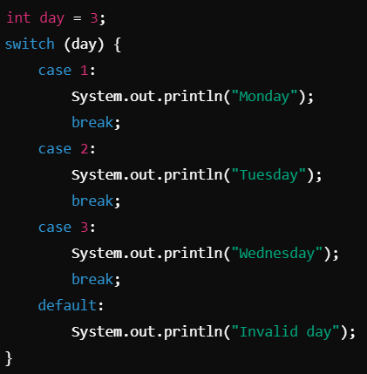
Control Statements – Conditional
switch-case statement:
The switch-case statement allows you to execute different parts of the code based on the value of an expression. It's often used as a cleaner alternative to long if-else chains.

Slide 16


Control Statements – Looping
for loop:
The for loop is used when the number of iterations is known beforehand.
Syntax

Slide 17
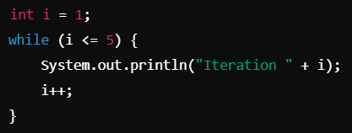

Control Statements – Looping
while loop:
The while loop is used when you want to execute a block of code repeatedly as long as the condition remains true.
Syntax

Slide 18
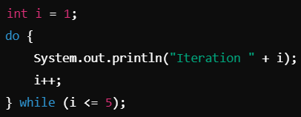

Control Statements – Looping
do-while loop:
The do-while loop is similar to the while loop, but the condition is checked after the loop body is executed. This ensures that the loop is executed at least once.
Syntax

Slide 19
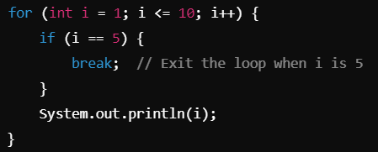
Control Statements – break and continue
break:
The break statement is used to exit the loop or switch-case immediately, regardless of the loop's condition.

Slide 20
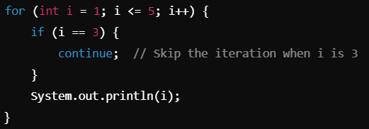
Control Statements – break and continue
continue:
The continue statement skips the current iteration of the loop and moves to the next iteration.

Slide 21
Object-Oriented Programming (OOP) in Java
Classes and Objects:
Creating objects and using constructors
Inheritance:
Single and multilevel inheritance
super and this keywords
Polymorphism:
Method overloading and overriding
Encapsulation:
Access modifiers and getter/setter methods
Abstraction:
Abstract classes and interfaces

Slide 22
Exception Handling
Types of exceptions
Checked
Unchecked
try, catch, finally blocks
Throwing and handling custom exceptions

Slide 23
Java Collections Framework
Importance
Common Interfaces (List, Set, Map)
Examples: ArrayList, HashMap, etc.

Slide 24
Threading in Java
Extending the Thread class
Implementing the Runnable interface

Slide 25
JVM and Memory Management
Heap Memory
Garbage Collector

Slide 26
Java 8+ Features
Lambda Expressions -> Functional Interfaces
Stream API
Method Referencing

Slide 27
Conclusion
Java's Strength: Its platform independence, object-oriented nature, and robustness make it ideal for building secure, high-performance applications.
OOP Concepts: Abstraction, encapsulation, inheritance, and polymorphism are the cornerstones of Java's architecture.
Java Collections Framework: Provides a comprehensive toolkit for data manipulation and management.
Multithreading: Enables Java to handle concurrent tasks, improving application efficiency.
Exception Handling: Ensures reliable program execution by managing runtime errors.

Slide 28
Thank You!
Under the Guidance of Indrakka Mam
Edubridge x Capgemini

